Slide 1


PREDICTING RISK PROFILE FOR MULTIPLE FOLLOW UP CASES AT HEALTHCARE INSTITUTIONS
Team Members : Catherine Selvina Bernice Andavan , Vasavi E,
Swathi Gopinath, Pooja Pandey, J E Prarthana
Mentored by : Mr. Dipanjan Goswami
Batch : DSE JAN2020 – Group 5

Slide 2
TABLE OF CONTENTS
INTRODUCTION
EXPLORATORY DATA ANALYSIS
UNSUPERVISED LEARNING
SUPERVISED LEARNING
BUSINESS
SOLUTION

Slide 3
Problem Definition
Identifying the factors that influence the risk level/category of an individual and multiple follow up visits in an healthcare institution.
To improve the affordability and accessibility to healthcare sector of our country by predicting the CVD risk in people.
This helps people in rural india who have poor medical infrastructure and least aware of lifestyle diseases, by detecting the risk levels at preliminary stages providing them with medical counselling and medications to improve or stop onset of a disease.
Problem Solution
Segmentation of people to various risk levels : low, medium and high-risk who turn up for the medical camp i.e., using screening data.
Correlating the labelled data thus obtained with the supplementary follow up data and understanding the parameters/factors that leads to multiple visits of people to the hospital in future.

Slide 4
PROJECT FLOW CHART
1. CONDUCTING SCREENING TEST
3. STUDYING THE CHARACTERISTICS OF DIFFERENT RISK LEVELS
2. SEGMENTING PEOPLE INTO DIFFERENT RISK LEVELS
5. FINDING THE ATTRIBUTES THAT CONTRIBUTE TO FOLLOW UP
4.MERGING SCREENING AND FOLLOW UP DATASET
6.SEGMENTING PEOPLE BASED ON THE FREQUENCY OF FOLLOW UP
7. IDENTIFYING THE FEATURES OF THE PEOPLE WHO COME FREQUENTLY

Slide 5
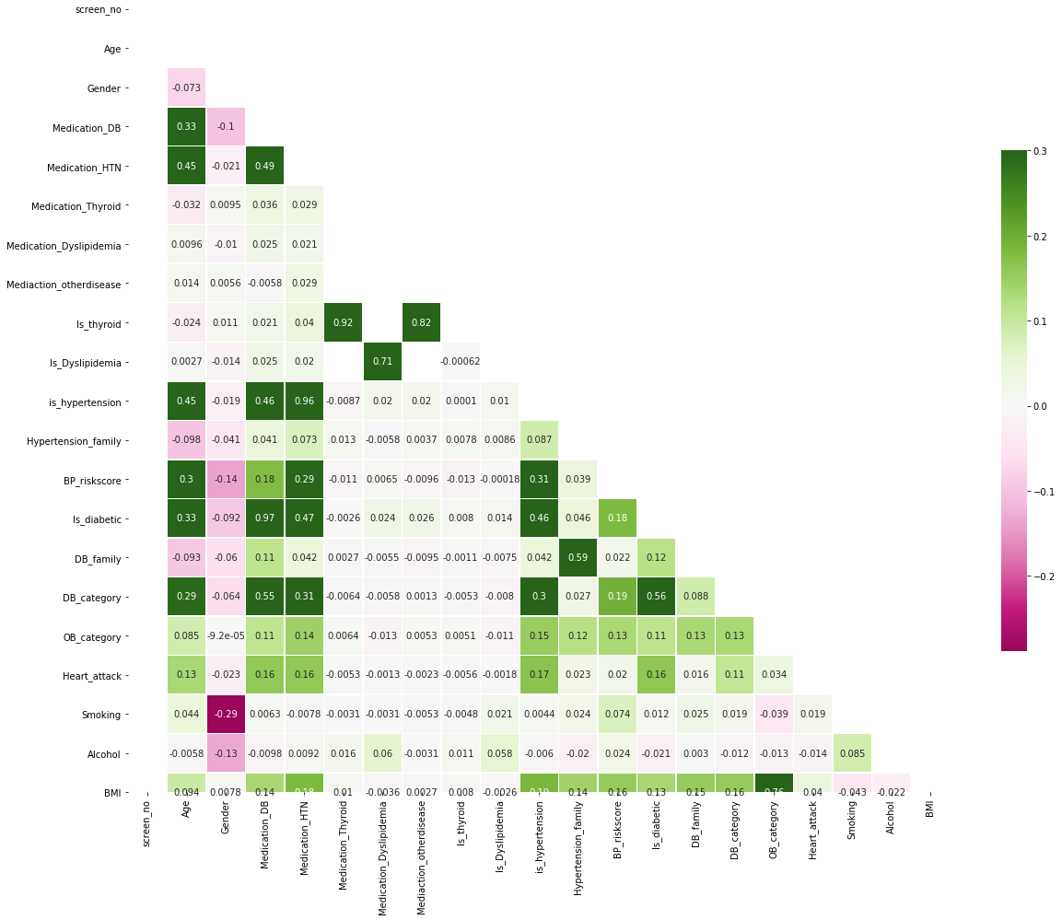
FEATURES CORRELATION
High correlation between disease state and its corresponding medication.
Obesity risk level and the BMI.

Slide 6
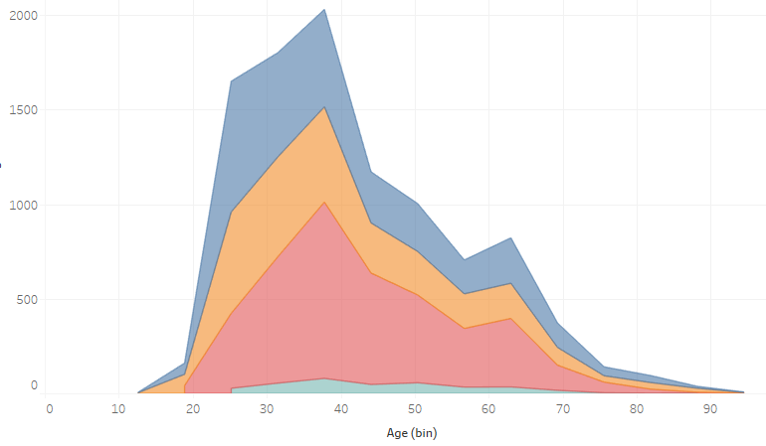
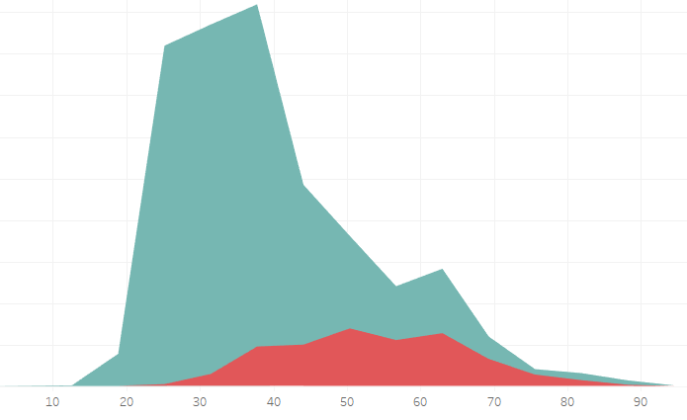


STATISTICAL TESTS
Anova : [ Continuous Vs Categorical ]
Analysis between Is_diabetic, OB_category and Age
H0 -> Mean Age of OB_category when grouped is the same;
Mean Age of Is_diabetic when grouped is the same;
Ha -> Means age is not the same.
AGE
AGE
Age | F - statistics | P - val | Comments
Is_diabetic | 1201.17 | 0.00 | H0 rejected
OB_category | 10.19 | 0.00 | H0 rejected

Slide 7
STATISTICAL TESTS
Chi square : [ Categorical Vs Categorical ]
H0 -> No relationship between features
Ha -> Association is present between features
Feature Vs Cluster | P-value | Significance | Comments
Medication_Dyslipidemia | 0.14 | H0 accepted | Does not contribute much to the cluster
Medication DB | 0.00 | H0 rejected | Highly associated with the cluster
BP_riskscore | 0.00 | H0 rejected | Highly associated with the cluster
Is_thyroid | 0.45 | H0 accepted | No relationship with the cluster
Alcohol | 0.49 | H0 accepted | No relationship with the cluster

Slide 8
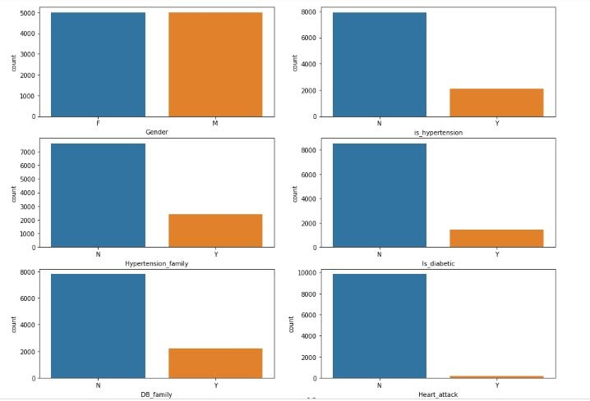
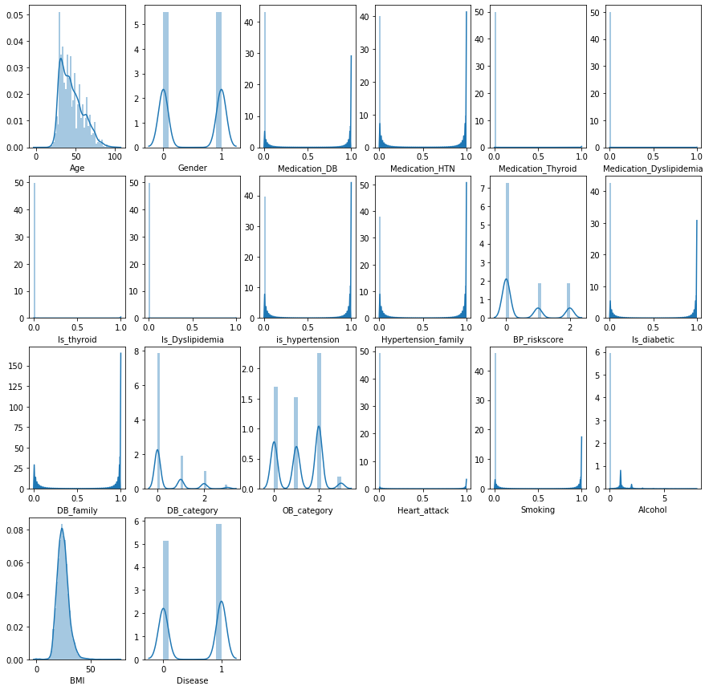
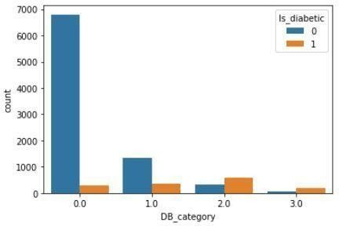
UNIVARIATE ANALYSIS
Countplot of various features
●The negatives form the majority i.e. people with no disease are more compared to people with the disease.
●Among the db_category category 2 has the highest count of positives. This means the majority of the people fall under the high-risk diabetes category.
●The median age for db_category type 2 is highest among all.
●Age of the sample between 4 to 100 with 50% of data lying between 35 and 55 years.
●More than 50% of BMI data lies in the range of 18.75 to 28.12.
Count Plot of DB_category feature

Slide 9
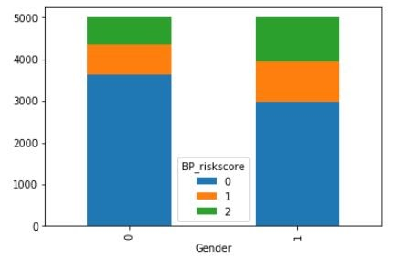
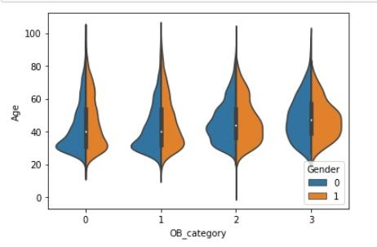
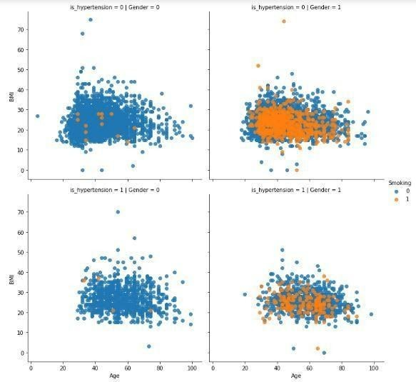
MULTIVARIATE ANALYSIS
Gender VS BP_riskscore
High BP risk is noticed among males more when compared to females.
Females are prone to less BP risk when compared to males.
Gender VS OB_category
The Obesity risk is high among younger ages for both males and females.
Both males and females show the same distribution of Obesity risk.
Hypertension vs BMI vs Gender
Males smoke more when compared to females.
Females with lesser age seem to have higher hypertension when compared to Males.
Among males with hypertension, the majority are non-smokers.

Slide 10
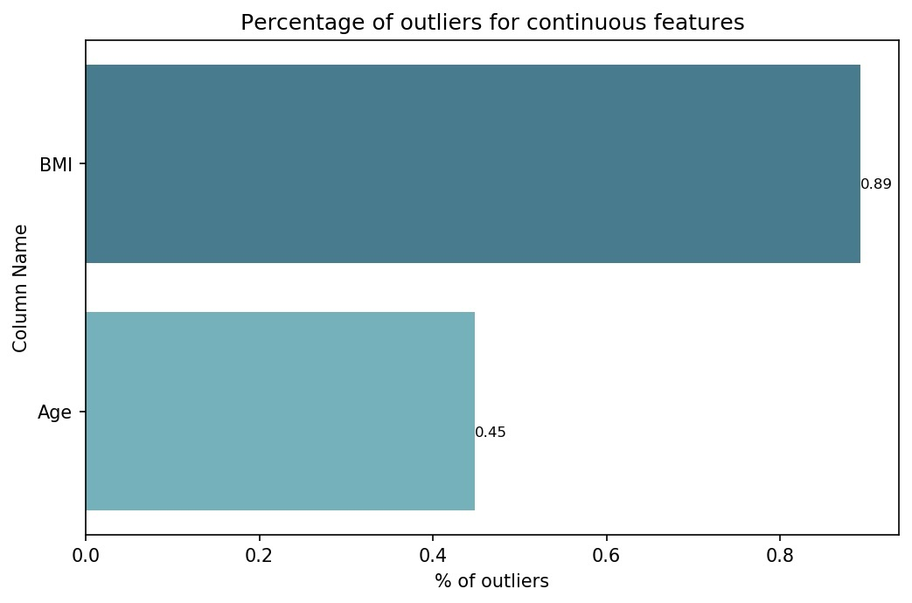
MULTICOLLINEARITY AND OUTLIERS
Variance Inflation Factor applied on screening data to detect the multicollinearity.
Outliers were detected for the two continuous features Age & BMI.
The percentage of outliers was negligible compared to the whole data size.
Variables | BMI | Is_diabetic | MedicationDB | is_hypertension | Medication_HTN | Age | Is_thyroid | Medication_thyroid | Disease
VIF | 27.651 | 19.9283 | 19.743676 | 17.1914 | 17.073153 | 12.06357 | 9.0702 | 9.06079 | 8.652814
Feature name | % of outliers
BMI | 0.8921
Age | 0.44

Slide 11
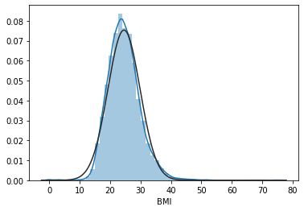
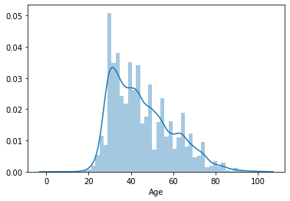
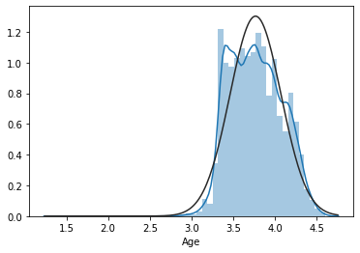
TRANSFORMATION
Transformation was applied on two two continuous features Age and BMI
BMI : No significant changes on applying different transformation techniques like log, square root and exponential. (Skewness : 0.81)
Age : Skewness before 0.73 .Reduced to 0.13 after log transformation

Slide 12
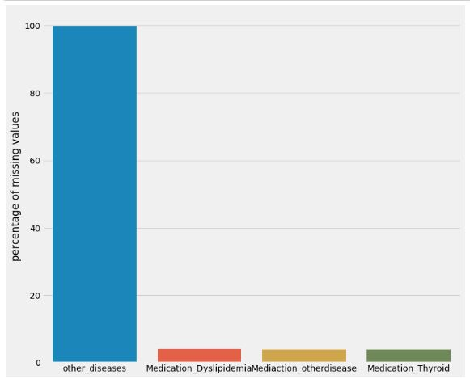
IMPUTATION TECHNIQUES
Imputation based on feature correlation.
Median and Mode Imputation.
Simple Imputer (strategy: Most frequent).
Iterative Imputer(strategy: Most frequent).
Features from screening sheet | % of missing values > 1%
other_diseases | 99.92
Medication_Dyslipidemia | 3.9
Mediaction_otherdisease | 3.84
Medication_Thyroid | 3.73
Medication_DB | 3.6
Medication_HTN | 3.02
% of missing data in the follow up sheet
Null values for the
Screening Data.
Model/Imputation | F1 Score
LR/Iterative | 0.9745
LR/SI | 0.9634
LR/Corr_imput | 0.92
DT/Iterative | 0.9787
DT/SI | 0.9684
RF/Iterative | 0.9933
RF/SI | 0.9833
DT/Median | 0.9666
LR/Median | 0.9216

Slide 13
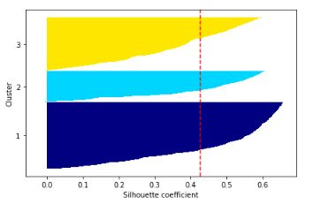
CLUSTERING
Clustering Algorithm | Silhouette Score
KModes | -0.08
K- Means | 0.397
Hierarchical Clustering | 0.40
K-Prototype | 0.425
The silhouette plot displays a measure of how close each point in one cluster is to points in the neighboring clusters .
This measure ie, Silhouette coefficients , has a range of [-1, 1].
( +1) indicate that the sample is far away from the neighboring clusters.
( 0 ) indicates that the sample is on or very close to the decision boundary between two neighboring clusters
( -1 ) values indicate that those samples might have been assigned to the wrong cluster.
K-Prototype algorithm gave us the highest Silhouette score.
Hierarchical Clustering gave us a descent score too, but its readability and interpretability was not proper.

Slide 14
CLUSTERS
CLASS 2: High risk (2042)
- Individuals who show high risk of hypertension and diabetics
- Age is high
CLASS 1: Medium risk (3585)
- Individual who show moderate risk of BP, hypertension and obesity
CLASS 0: Low risk (4371)
- Young Individuals who show high risk of obesity

Slide 15
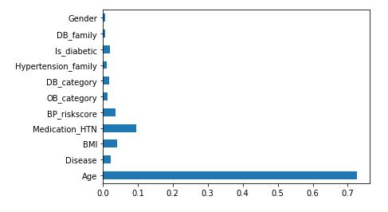
FEATURE SELECTION
Methods used for feature selection:
Backward elimination method
Extra Tree Classifier
Least significant features : Alcohol, Medication_Dyslipidemia and Is_thyroid.
Highest significant features : Age, medication_HTN, BMI, Disease, BP_riskscore, is_diabetic, OB_category
Advantage of Feature Selection :
Reduces over fitting
Less redundant data means less noise
Improves accuracy and computational time. .

Slide 16
MODEL BUILDING
Baseline models: Logistic​ Regression, Decision Tree, Random Forest
Random Forest : Taking Random forest as our main model we gained 16.66 % over variance error and compromised 12% over bias error ,so we decided to go with Random​ Forest​ as our final model.
Ensemble Methods
Model | Bias Error | Variance Error | Precision | Recall | F1 Score
Logistic |  | 0.000035 | 0.97 | 0.96 | 97.33%
Decision Tree | 0.0327 | 0.000045 | 0.99 | 0.99 | 96.73%
Random Forest | 0.0087 | 0.000005 | 0.98 | 0.99 | 99.13%
Model | Bias error | Variance error | F1 Score
Decision Tree | 0.0327 | 0.000045 | 96.73%
Random Forest | 0.0087 | 0.000005 | 99.13%
Cat Boost | 0.007 | 0.000006 | 99.3%
Gradient Boost | 0.008 | 0.000009 | 99.2%

Slide 17
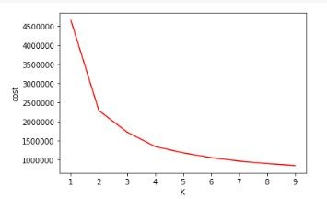
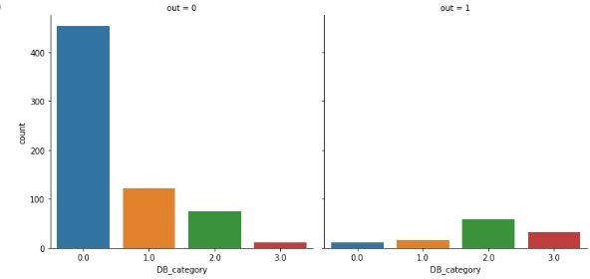
FOLLOW UP
KPrototype clustering gave us to two clusters with a silhouette score of 0.58.
DB_category by clusters:
Clusters | 1 or 2 Follow ups | >2 Follow ups
Class 0 | 27.5% | 72.5%
Class 1 | 51% | 49%
Elbow plot for K Prototype clustering on merged data
More than 75% of the people who are healthy and revisit are of the age less than 37 and also majorly males turn up for follow ups, compared to females.
Overall, Obesity and being diabetic plays a major role in multiple follow up visits of the individuals.

Slide 18


BUSINESS RECOMMENDATION
Healthcare start-ups :
Medical networking apps like Portea medical, Curofy, Tricog health services and Tattvan help doctors diagnose and cure diseases faster and better.
These startups aim at providing affordable and accessible healthcare services and thus conduct health camps across the country.
Our model can help these startups to figure out the attributes that influence the follow up and target the right audience to make the camp cost effective.

Slide 19

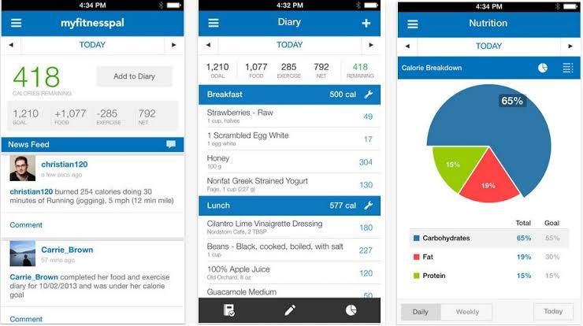
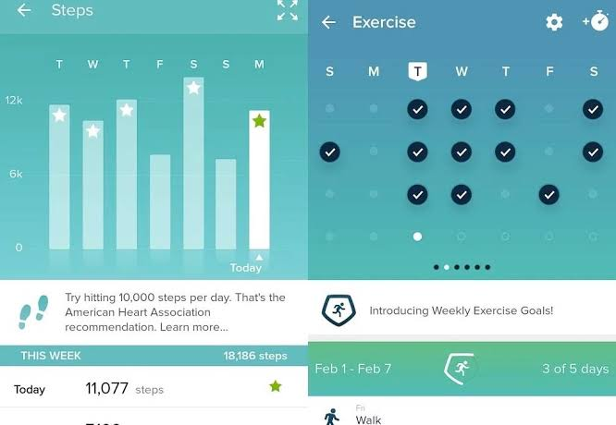
Fitness apps:
We can recommend our solution to fitness apps like healthify me, my fitness pal, fitbit, life sum etc,.
Helping them in curating diet plans, physical exercise, meditation, and medication intake reminders for those who have modifiable risk factors that can be eliminated through medical intervention or lifestyle changes.

Slide 20


Government schemes and other NGOs:
Incorporation in schemes like Pradhan Mantri Swasthya Suraksha Yojana, National Ayush Mission (NAM) , National Program for the Healthcare for the Elderly.
By using our models we can make disease detection easy and bring out cost effective healthcare solutions to the society .

Slide 21
Thank you

